Slide 1



Automate the BORING Stuff
Using the Blackboard API with Python @ WCC
Dave Lacerte WCC LMS System Administrator

Slide 2
Blackboard is Boring? : What do you mean

Slide 3


Some Blackboard Admin can be Boring!
bor·ing /ˈbôriNG/ adjective
definition: not interesting; tedious, repetitious
synonym: tedious, dull, monotonous, repetitive, mechanical;
usage: “Creating thousands of courses by cutting and pasting info from this spreadsheet into our Blackboard system could get rather boring"

Slide 4
What is an “API” ?

Slide 5

What is an IPA ?
IPA eye-pee-eh
noun: IPA; abbreviation: India Pale Ale synonym: BEER
definition: a light-colored beer similar to bitter, with a higher than average alcohol and hop content.
usage: “drinking Belgium IPA makes learning the Bb API less boring”

Slide 6

What is an API?
API eh-pee-eye
noun: COMPUTING
abbreviation: Application Programming Interface
definition: a set of functions and procedures allowing the creation of applications that access the features or data of an operating system, application, or other data service.
usage: “This API makes it easy to get data from my LMS”

Slide 7
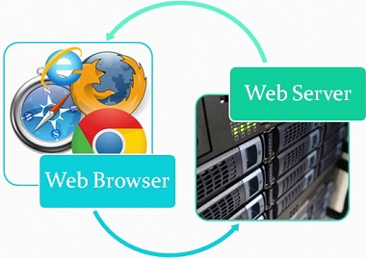
Web Servers serve HTML data to Web Browser Users Data Servers serve JSON data to API Client Applications
Web Browser users request data from a Web Server using HTTP protocol
Web Servers return the data in HTML format
API Client programs request data from a Data Server
Data Servers return data to the API client application in JSON format

Slide 8
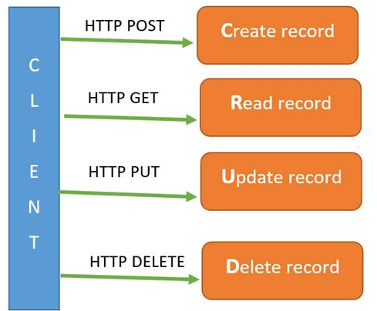
What Can I do with the Bb API?
Most APIs allow a client program to control/handle data on a server in 4 ways:
These 4 operations are sometimes referred to as CRUD operations
API’s enable client apps to perform CRUD operations on data server resources
Blackboard LEARN is a Data Application Server that serves Educational Course/Student/User/Content/Grades DATA in SEVERAL different ways:
using data formatted as HTML (to a PERSON using a web browser client program)
using data formatted as JSON (to a REST API client program)
using data formatted as XML (to a SOAP API client program)

Slide 9


REST API vs SOAP API
REST = REpresentational State Transfer
REST API’s return data in JSON format (JSON = Java Script Object Notation )
REST = data requests and responses are stateless in a (RESTful) way
REST API clients send data requests for a data resource to a server:
ie) REST API client sends a GET request to fetch a USER resource from the Data Server
SOAP = Simple Object Access Protocol
SOAP API’s return data in XML format ( XML = eXtensible Markup Language )
SOAP uses a stateful Service Oriented data exchange model (not RESTful)
SOAP API clients remotely connect to a Data Service program running on an App Server:
ie) SOAP API client connects to a getUSER service which is always running on the App Server
NOTE: Using the SOAP API with Blackboard is now discouraged/deprecated/unsupported:
https://community.blackboard.com/thread/3777-soap-web-service-end-of-life

Slide 10
API programs use API ENDPOINTS: Endpoints tell client apps how to request Data Resources
Web browser users specify URLs to connect to a web server ‘page’ of data
API client applications specify API ENDPOINTS to connect to a data server to perform CRUD operations on data elements.
API client programs can be written in many programming languages
Java, PERL, Python, C, C++, C#, NodeJS, Shell/CURL, Go, Haskell, etc…

Slide 11

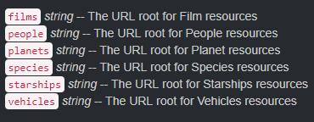
DEMO1: Star Wars API
The STAR WARS API data server is available at https://swapi.co/api
This API exposes various API ENDPOINTS for different types of STARWARS data:
A simple API data request can be sent to the PEOPLE endpoint of the STARWARS data service using the CURL command:
C:\>curl https://swapi.co/api/people/?search=boba
CURL = Client URL originally found on Linux systems, but now included in Windows10

Slide 12
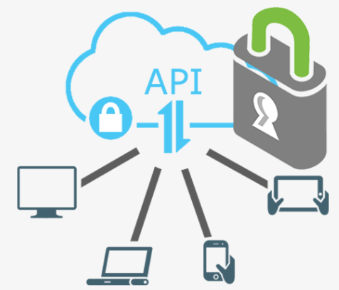
BLACKBOARD API Client ACCESS SECURITY
Access to Star Wars API Data is Unrestricted (zero Authentication!)
Access to Blackboard API Data is Restricted and requires Authentication
The Blackboard Administrator controls:
- whether the API data service is ENABLED or DISABLED via the System Admin Interface
- which specific API client APPLICATION IDs can connect to the Bb server to request data
Each API client app must be registered on the developer.blackboard.com website:
- the API client app is assigned a unique APPLICATION ID and APPLICATION NAME
- a Public APP KEY (userid) and Private/Secret APP KEY (secret password) are assigned

Slide 13
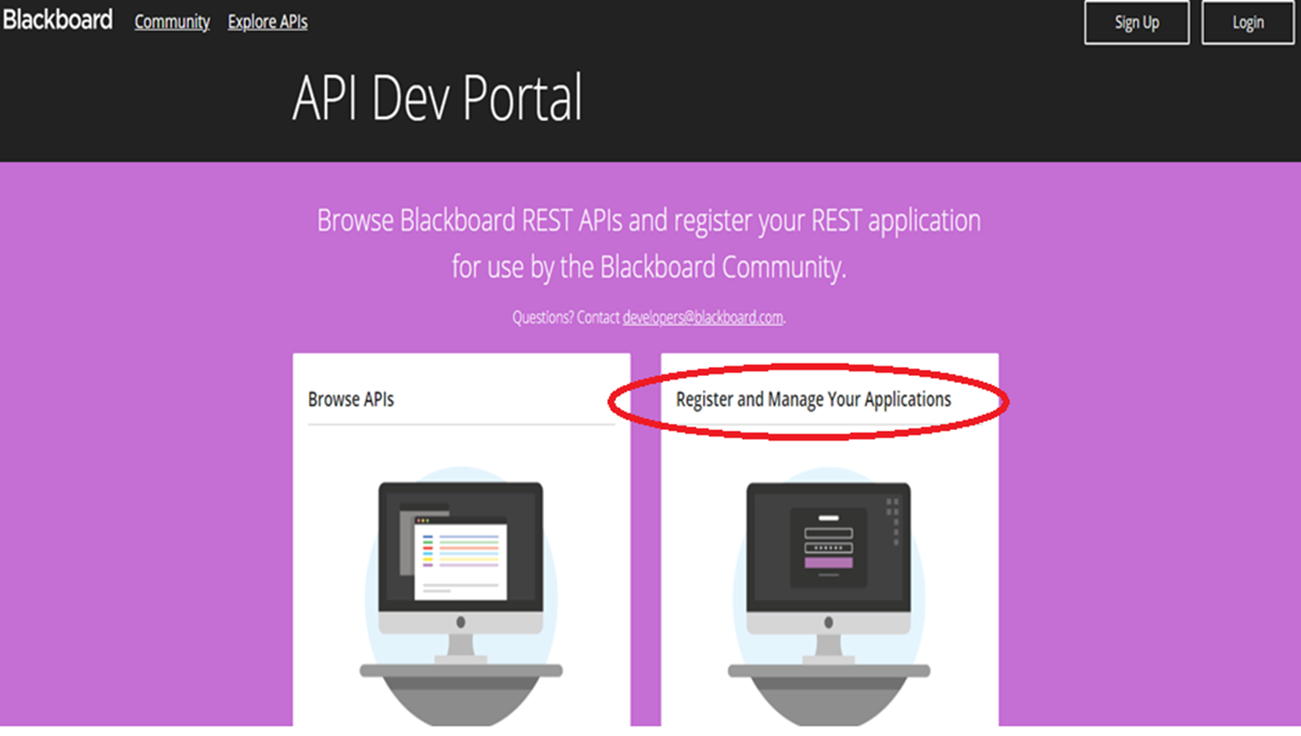
Bb API Dev portal: Register API client Apps

Slide 14
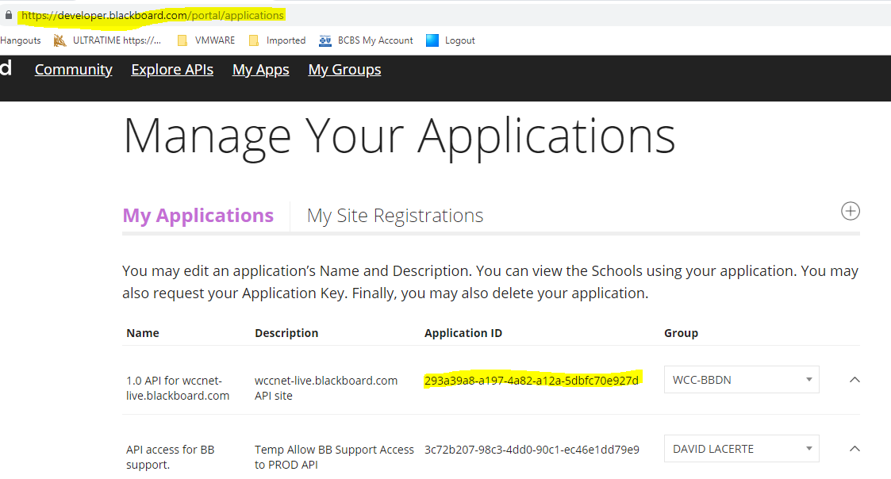
Bb API client REGISTRATION on Bb DEVELOPER SITE

Slide 15
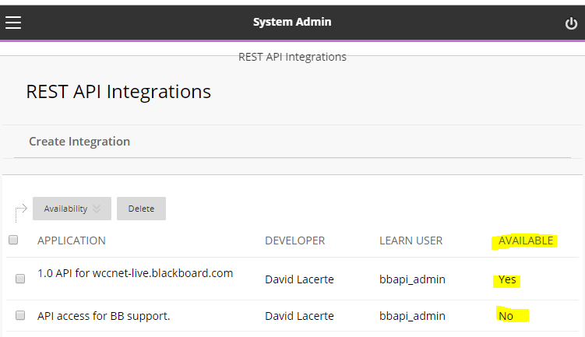
Bb SYSTEM ADMIN can enable/disable API services

Slide 16
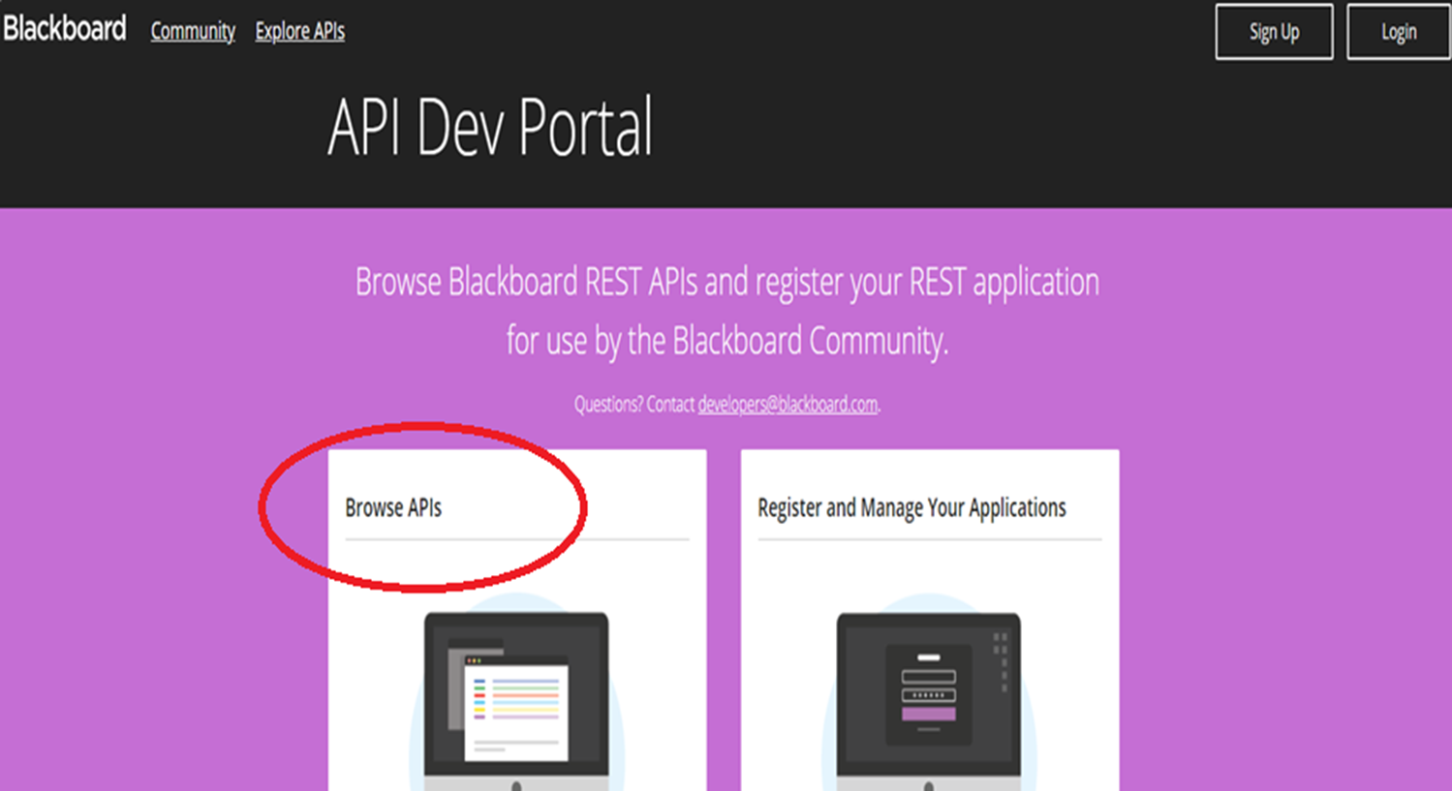
Which Endpoints does the Blackboard API expose to API client programs?
Bb API DATA Endpoints are documented on the developer.blackboard.com site

Slide 17
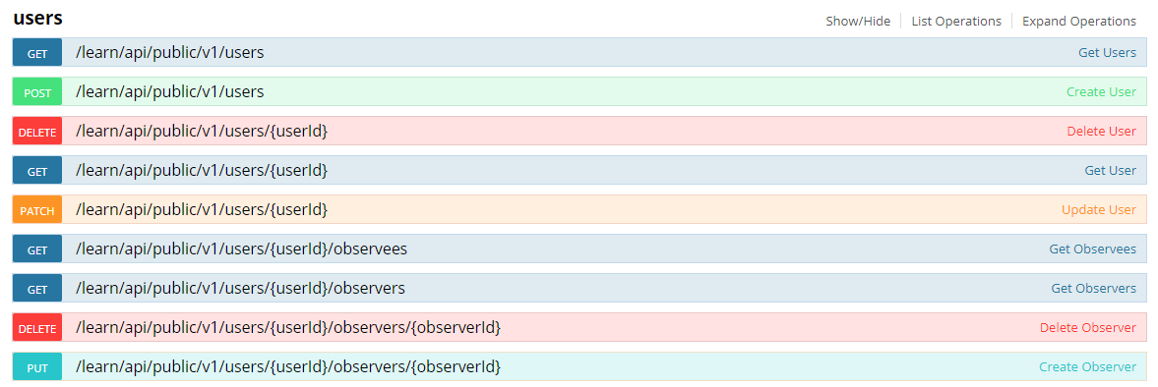
Blackboard REST API DOCUMENTATION
Describes all of the Bb API Endpoints that an API client app can access or utilize
Here is a list of the API Endpoints for accessing the Bb USERS data resource

Slide 18
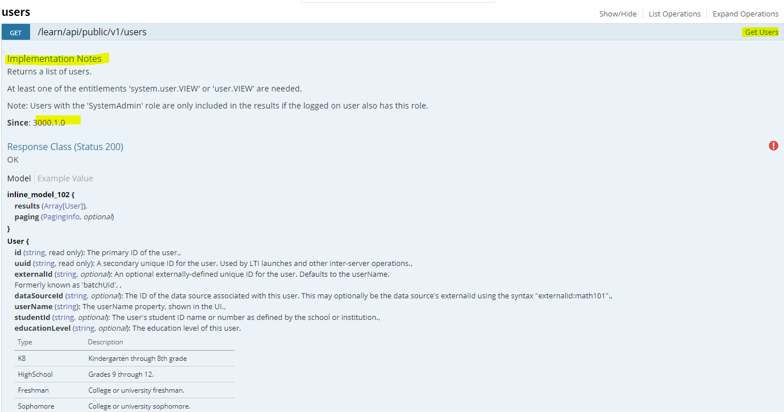
The Dev site documents each Bb API Endpoint in great detail
Each API endpoint has detailed ‘implementation Notes’ which describe the version of LEARN that supports that Endpoint, how to use it, what data it returns
Select any Bb Endpoint to view implementation and usage details for that item

Slide 19
Bb provides examples of using CURL with the API
This Bb site demonstrates using CURL as a simple Bb API client:
https://community.blackboard.com/docs/DOC-1767-rest-demo-using-curl
The Bb Data service requires an Authentication request before a Data request.
Two CURL commands are needed to process a Bb API Data Resource request:
1) CURL sends APP ID and Secret KEY to request an AUTH TOKEN from the OAUTH2 Endpoint (token request)
2) CURL sends the AUTH TOKEN to a specific API Data Endpoint (data request)
Multiple API requests, to different API Data Endpoints, can be sent while the AUTH TOKEN is still valid.
AUTH TOKEN automatically expires and becomes invalid after 30 minutes

Slide 20

DEMO2: Bb API Data Access using CURL command
1) Use the CURL command to request a new OAUTH2 token from the Bb server
2) Request Data from an API Endpoint on the Bb server using the valid OAUTH2 token
3) OAUTH2 token can be re-used for other Data Resource requests until it expires

Slide 21

CURL is not the BEST API client to use!
The CURL command is a simple way to demonstrate how the Bb API works
You could implement a complete Bb API client program using CURL, but it would not be easy to do so
A better approach would be to use a modern programming language to create your Blackboard API client app
Most modern programming languages support sending API requests via HTTP and receiving and parsing the JSON formatted data responses
At WCC I have chosen to use Python for the creation of several Blackboard API client application scripts

Slide 22



Why PYTHON?
2 years ago I did not know how to code in Python.
Many years ago I had developed programs in C, Ruby and PERL, but I had not programmed anything significant for almost 12 years.
I tried to use PERL initially, but found I was “rusty” and essentially would need to re-learn it from scratch, and the PERL developer community seemed much less active than 15 years ago.
My daughter used Python 10 years ago in a robotics camp! (so, how hard could it be?)
PERL did not seem to have the extensive set of user contributed library modules I needed to handle the API requests and resulting JSON data easily
Python has an extensive library of modules ( an API toolbox! )
There is a huge online community of active Python developers.
The language is named after Monty Python, not the Snake…
So it’s a FUN programming language with a sense of humor!
(How many other programming languages include Easter Eggs?)

Slide 23

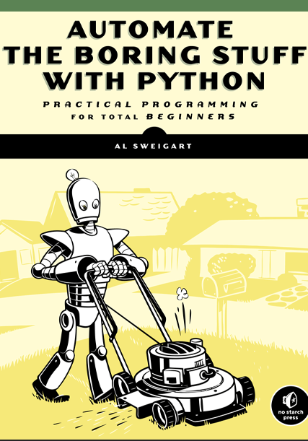
Learning PYTHON: Fun :-) Beginner Books
The first book I read was: Python Crash Course – Eric Matthes
The 2nd book: Automate the Boring Stuff with Python – Al Sweigart
had many practical application and program ideas that I could immediately use.

Slide 24


More Serious ☹ PYTHON REFERENCE BOOKS that I Use

Slide 25

bbapi-user API client script: Python Modules
My goal was to create a script to perform CRUD operations on USER records.
Many python modules made this task relatively easy:
1) argparse module was used to create command line arguments/options and Help menus
2) requests module provided functions to submit API requests to API endpoints using HTTP
3) json module contained functions for handling JSON formatted data in python data structures
4) os module provides operating system functions to manage files, file-paths
But, what is a Python Module?
Python Modules = functions that someone else coded for you!

Slide 26
DEMO3: Python STARWARS API client = 3 lines of code!
Create a simple STARWARS API client program with three lines of python code:
1) IMPORT the powerful python REQUESTS module
import requests
2) Call the GET function to request data from an ENDPOINT and store the result
result = requests.get(‘https://swapi.co/api/people/?search=boba‘ )
3) Print the JSON data contained in the result variable
print( result.json() )

Slide 27
Start with a simple API client that sends a data request to one specific Endpoint
My initial bbapi-user API script simply fetched one USER record from the Bb server USER Endpoint.
Once the basic READ data operation worked, I added DELETE, UPDATE, and CREATE functionality to the script
Handling too much CRUD all at once can get messy!
CREATE and UPDATE are a bit more difficult; You need to send some JSON data to the Server along with the API endpoint request,
The server uses the JSON data to create/update the data resource properties.

Slide 28
Adding new features to bbapi-user script
WCC has three Bb SaaS environments running in the AWS Cloud:
LIVE (production data),
STAGE (clone of production)
TEST (no data, newer release version of Bb LEARN)
So I added the –t option to the script to specify the TARGET server for the API request using the ARGPARSE module
bbapi-user –t TEST get userid
bbapi-user –t STAGE get userid
bbapi-user –t LIVE get userid

Slide 29
Adding a ‘help menu’ to bbapi-user: with the ARGPARSE module
bbapi-user -–help will display Command-Line Usage and Help information
-bash-4.1$ bbapi-user --help
usage: bbapi-user [-h] [-t TARGET] {get,create,list,update,listall,delete} ...
Process some command line Arguments
positional arguments:
{get,create,list,update,listall,delete}
operational commands: get, list, update, create, delete
update update USERID records parameters
get get single user record
list list all USERIDs like the USERID
listall list all USERIDs
delete delete USERID
create create USERID
optional arguments:
-h, --help show this help message and exit
-t TARGET, --target TARGET
-t TARGET_BB_INSTANCE: TEST, STAGE, LIVE

Slide 30
DEMO4: bbapi-user API Client Script
Get basic USER information: bbapi-user get USERID
Change email address of USER: bbapi-user update USERID –e EmailAddress
Create a USERID: bbapi-user create USERID –e Email –f last –g first –p PWD –n NETID
Delete a USERID : bbapi-user delete USERID

Slide 31
Creating new API client scripts:
Once I had a basic bbapi-user script working, I created a new bbapi-course script
Approximately 80% of the code is the same between the scripts I developed:
bbapi-content - CRUD for Bb course content items
bapi-dsk – CRUD for Bb Data Source Key DSK management
bbapi-course-membership – CRUD for course enrollments; Students/Instructors
I did not try to create Bb API scripts for ALL of the available Bb API endpoints!
But, with just a few basic API scripts in place:
I could Automate some boring processes and tedious tasks related to Blackboard Administration

Slide 32
DEMO5: bbapi-course & bbapi-course-membership API Client Scripts
Copy a COURSE: bbapi-course copy SOURCE –d DESTINATION
Read Course Info: bbapi-course get NEW_LACERTE_SANDBOX
Enroll Instructor: bbapi-course-membership create COURSE USER –r Instructor
Delete Course: bbapi-course delete NEW_LACERTE_SANDBOX

Slide 33

The original ‘boring’ WCC Bb course copy process
Instructors submitted COURSE copy REQUESTS to our help-desk via a webform.
The requests were documented and course copy info was collected and entered into a spreadsheet (or two)
Staff workers were employed to manually copy/create each of these new courses and check them off the spreadsheet as completed.
Staff sent email to the Instructor to notify them that the new course was available, and the help desk “course copy request” ticket was marked ‘closed’

Slide 34

Automated Course Copies @ WCC
We did NOT try to change the existing HELP DESK COURSE COPY REQUEST WORKFLOW!
We still collect Course Copy requests into an XLSX spreadsheet (because we like to party like it’s 1999!)
Six manual Steps were automated to complete these (old school) course copy requests:
1) Create a CSV file directly from the XLSX Excel file containing course copy requests
The new course copy request CSV file has the following format:
TERM, CRN, SOURCE, TARGET, NAME, ENROLLMENTS
201905,51299,D_MASTER-ENG-200-DL,W_ENG-200-DL-DW1-AR-S19,ENG 200: Shakespeare Online DW1 Spring 2019,ariedy|gecclest
2) Use an API call to create an exact copy of the old course-ID as a new course-ID
3) Rename the new course name (long descriptive name)
4) Remove all existing enrollments (since API only performs EXACT copy)
5) Enroll assigned Instructor(s) into the course
6) Notify Instructors via email that new course is available

Slide 35

DEMO6: AUTO COURSE COPY FROM XLSX FILE
1) CSV file is created from the XLSX spreadsheet on a network drive
2) CSV FILE is checked to ensure it contains VALID data
3) pending course copy requests from CSV file are stored into SQLITE database
4) pending copy requests are read from database and the bbapi-course and bbapi-course-membership commands are executed in sequence:
- perform an exact copy of SOURCE Course to TARGET Course
- alter new course as unavailable to students
- un-enroll all users, Students and Instructors
- enroll new Instructors into the new course
- change course descriptive name
- email Instructors that new course is ready
5) Mark the course copy as complete in SQLITE database

Slide 36

Beyond API calls – Using Python to access Website data and control Web browsers
The Bb API is great, but it cannot do everything…
The Bb API does not ‘expose’ every possible Bb data operation as an API Endpoint
For example: It cannot create Archives of courses, or Download course archive ZIP files
BUT, not everything has to be done via the API:
The “Automate the Boring Stuff” book has a few chapters describing how to use python to extract data from HTML webpages (web scraping) using the Beautiful Soup module and the Requests-HTML module.
Another chapter describes how to how to program the control of a web browser (browser automation) using the Selenium module. Instead of a person manually moving the mouse and point/click on webpage menu selection items, the browser is controlled by the power of python!

Slide 37


DEMO7: Using Python SELENIUM module to Archive Courses by controlling a CHROME WEB BROWSER
The Selenium web driver module allows a python program to interact with and control a web client program (Firefox/Chrome/etc) instead of manually pointing/clicking to accomplish a certain task on the Bb server.
I used this method to Archive thousands of old courses before deleting them
A similar python script allowed me to download these same archives to our SAN storage system

Slide 38
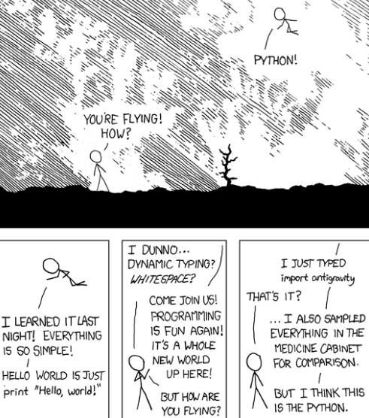
Make your BLACKBOARD Data ‘FLY’ using Python with the Bb API
Interact with the powerful Blackboard API using Python
Learn about Python MODULES to make API client programs EASY to code: import antigravity ->
Find a boring Bb operation that you perform manually and automate it!
Join a Python User group: view YouTube Python Tutorials
You do not have to create a script that uses ALL of Bb API Endpoints at once
KISS – Keep It Small and Simple to start.
Take control of your Bb data and make it ‘FLY’
Enroll in the WCC Python Programming Class: CPS 141 !

Slide 39
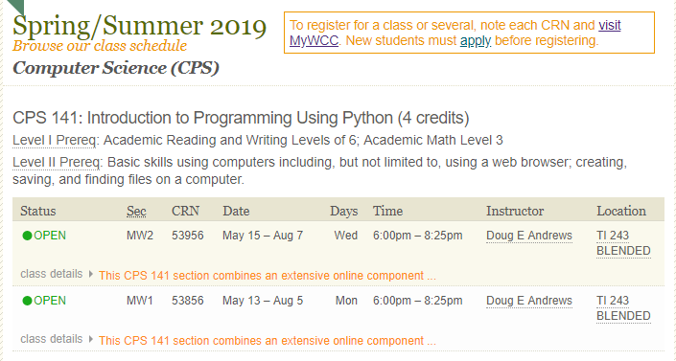

Enroll in a WCC Python class: CPS 141 Introduction to Programming Using Python

Slide 40

Just like Monty Python’s parrot, my presentation is DONE/DEAD/OVER/KAPUT! Thanks for attending!

Slide 41









Pythonic Programming Resources
https://www.python.org Python Software Foundation site
https://coreyms.com Beginner and Advanced Python Tutorials (YouTube)
https://2.python-requests.org Python Requests Module: HTTP for Humans
https://www.crummy.com/software/BeautifulSoup Python HTML web scraper
https://developer.blackboard.com/ Blackboard Developer API website
https://michipug.wordpress.com/ Python User Group @WCC 1st Thursdays
https://nostarch.com/pythonforkids Teach Your Kids Python!
https://www.oreilly.com/ O’Reilly Learning, Books & Programming resources
https://www.pythonanywhere.com Free Cloud based Python Dev Environment
https://nostarch.com/ The finest in geek entertainment (and Python books)
https://stackoverflow.com/ Answers all your python/programming questions

